Slide 1

Autonomous Restaurant Serving System using Food Image Detection and Voice Detection
15EC496L Major Project
Project Domain :
Signal Processing
Made By:
RA1611004010573- Soham Dasgupta
RA1611004010745- Yogalakshmi C.N.
RA1611004010608- Madhurupa Samaddar
RA1611004010123- Subiksha
Project Guide:
Dr. K Vijayan
Project Coordinator:
Dr. P Vijayakumar
4th Year, 2019-2020
Department of Electronics and Communication Engineering
SRM Institute of Science and Technology, Kattankulathur,
Tamil Nadu -603203

Slide 2
Index:
Slide 1: Project Title and Other Details
Slide 2: Index
Slide 3: Abstract
Slide 4: Objective
Slide 5: Problem Statement
Slide 6: Proposed Solution to the Problem
Slide 7 to 8: Literature Survey
Slide 9: Novelty of The Project
Slide 10: Database
Slide 11 to 16: speech recognition
Slide 17: Image detection
Slide 18: Object recognition
Slide 19: Object recognition
Slide 20: How object recognition works?
Slide 21: How voice recognition works?
Slide 22: Integrate object recognition in a single work flow
Slide 23: Acceptance of the paper in a conference
Slide 24 to 25: Reference
Slide 26: Team role

Slide 3
Abstract:
Currently in India multiple food chains are running out of which many food chains are running internationally too. One of the most important aspects of these chains is the management of customers and customer satisfaction.
The first part of this project aims at intelligently predicting the choices and the personal details of the customer. This prediction is done through voice recognition where the voiceprint of a person is detected to access the database of the person which consists of his/her previous orders and special changes in the menu.
The second part of the project deals with the food item detection algorithm using image processing so that veg and non veg food items do not get mixed up and the correct table receives the correct order.

Slide 4
Objective:
The primary objective of this project is voiceprint recognition of the person so that the customer is not asked for additional personal details and also the database of the customer can be easily recognized using the voiceprint. This database can be used to customize the order for the customer making it easier for the restaurant or hotel to manage the customers.
The Secondary objective of the project is the detection of food items using image processing so that the correct order is always sent to the correct table . Moreover Vegan meals thus will never be mistaken for non veg meals .

Slide 5
Problem Statement:
The project aims at creating a personalized database which can be accessed through the voice recognition of the customer so that the customer never faces a problem in overseas outlets of the similar food chain.
The second problem statement is that veg and non veg foods get mixed up creating problems for customers.
The project aims at segregating veg and non veg food intelligently so that people with specific food choices (Jains and Vegans) never face a problem also to sort things out voice recognition.
In this progress, we have created an app that can store all the datasets and works customer friendly. This helps the users to enjoy the tension free meal in adding specifics to their meal.

Slide 6
Proposed Solution to the Problem:
Voice detection
An effective algorithm(MFCC) should be set up for the feature extraction of the voice.
The data from the customer must be entered into the master database which is shared among all the systems.
A shared database over the internet among all the systems would ensure that the person also gets similar facilities while visiting an outlet of the restaurant in a different country.
Image Detection
A multilayer perceptron must be trained multiple times for effective detection of the food items.
Colored dots on plates and food packages can be used for segregation of veg and non veg items.

Slide 7
Literature Survey:
AUTHOR | PAPER | CONTRIBUTION | INFERENCE
Jianliang Meng, Junwei Zhang,Haoquan Zhao | Overview of the Speech Recognition Technology | Application of hidden Markov model in speech processing | Speech recognition using Markov Model, Hybrid Network model and Neural Network
Gulmira K Berdibaeva, Oleg N Bodin, Valery V Kozlov, Dmitry I Nefed, Yaroslav A Pizhonkov | Pre-processing Voice Signals for Voice Recognition Systems | Autocorrelation sequence, SRS, checking phenome checking | Separation of speech into phenomes Through RMS envelope
Taichi Joutou and Keiji Yanai | a food image recognition system with multiple kernel learning | Multiple Kernel Learning and SIFT | propose a food image recognition system employing the MKL-based feature fusion method. By estimating the optimal weight to combine different image features with MKL

Slide 8
Literature Survey:
AUTHOR | PAPER | CONTRIBUTION | INFERENCE
Daniel E. Huddleston,Jason Langley, Jan Sedlacik,Stewaet A.Factor, Kai Boelmans and Xiaoping P.Hu | Food Recognition by Combined Bags of Color Features and Texture Features | Measured the neuromelanin-sensitive MRI contrast changes in the lateral-ventral tier of substancia nigra pars compacta in PD | Identified a region in the lateral-ventral snc prone to iron accumulation.
Weishan Zhang, Dehai Zhao, Wenjuan Gong, Zhongwei Li, Qinghua Lu, Su Yang | Food Image Recognition with Convolutional Neural Networks | a food image recognition system with convolutional neural networks(CNN) | Error Rate: Gray : Fruit Image- 19.2% Multi Food Images – 29.1% RGB : Fruit Image-15.5% Multi food images – 46.5%

Slide 9

Novelty Of The Project:
Every aspect of business and living is completely focused on automation nowadays.
This project aims at the automation procedure of taking orders and serving them in hotels and restaurants.
Currently available AI enabled hotels have an unnecessary heavy cost since multiple functions are performed by robots.
This project aims at serving a similar purpose at much cheaper rates.

Slide 10
Database
This part deals with data retrieving and data entering. As there are many food chains spread across many places around the world.
This is the first part of this project which aims at intelligently predicting the choices and the personal details of the customer. This helps in knowing about the allergic reactions of a person to some specific food items and a customizable menu can be provided to the person
This has been done by making an app so that it is easier to keep the records of all the customers.

Slide 11
SPEECH RECOGNITION
Speech recognition is an interdisciplinary subfield of computational linguistics that develops methodologies and technologies that enables the recognition and translation of spoken language into text by computers.
It is also known as automatic speech recognition (ASR), computer speech recognition or speech to text (STT).
It incorporates knowledge and research in the linguistics, computer science, and electrical engineering fields.

Slide 12
SPEECH RECOGNITION
Some speech recognition systems require "training" (also called "enrollment") where an individual speaker reads text or isolated vocabulary into the system.
The system analyzes the person's specific voice and uses it to fine-tune the recognition of that person's speech, resulting in increased accuracy.
Systems that do not use training are called "speaker independent"systems. Systems that use training are called "speaker dependent".

Slide 13
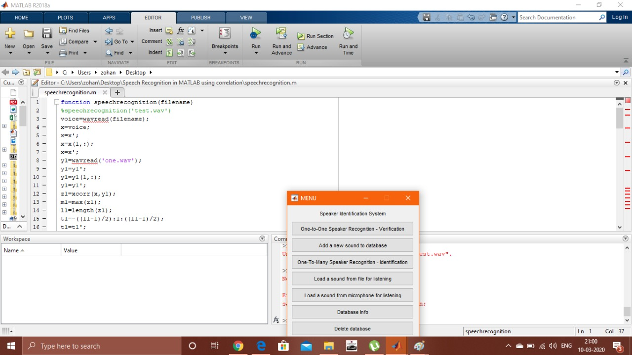
SPEECH RECOGNITION

Slide 14
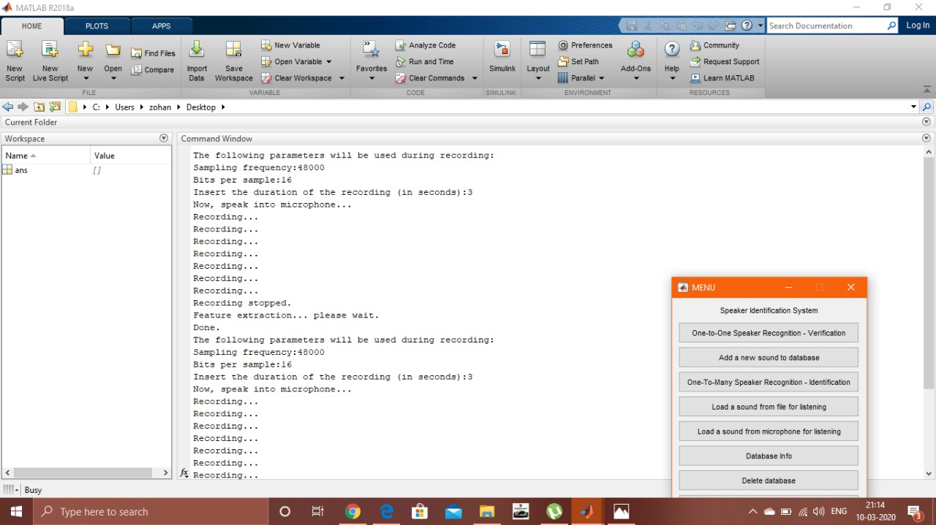
SPEECH RECOGNITION

Slide 15
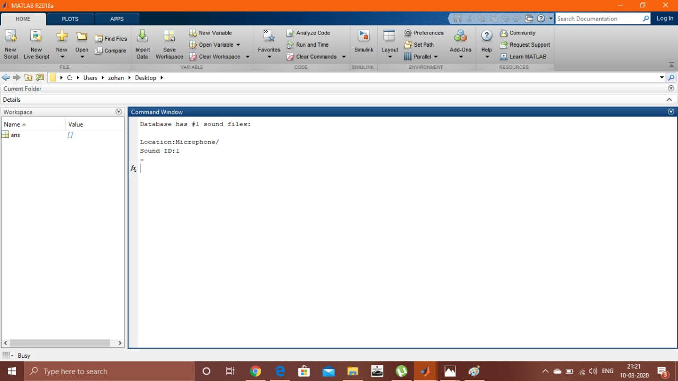
SPEECH RECOGNITION

Slide 16
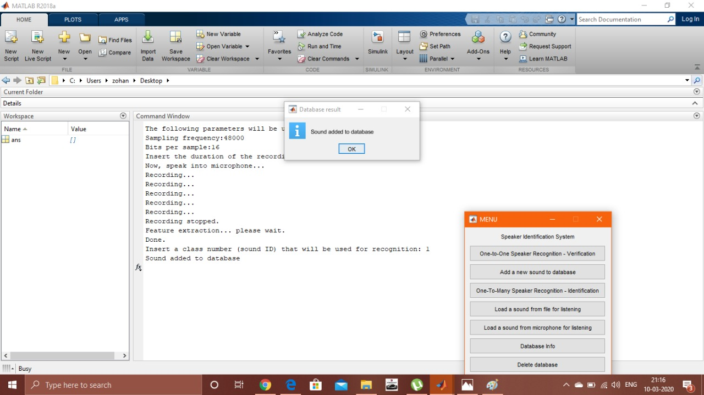
SPEECH RECOGNITION

Slide 17
Image Detection:
Object recognition is a computer vision technique for identifying objects in images or videos , classify, and track objects or events in order to ”understand” a real-world scene. Programming a computer and designing algorithms for understanding what is in these images is the field of computer vision.
Object recognition is a key output of deep learning and machine learning algorithms.
The goal is to teach a computer to do what comes naturally to humans: to gain a level of understanding of what an image contains. The relations and interactions among these objects are the key factors for scene understanding.

Slide 18
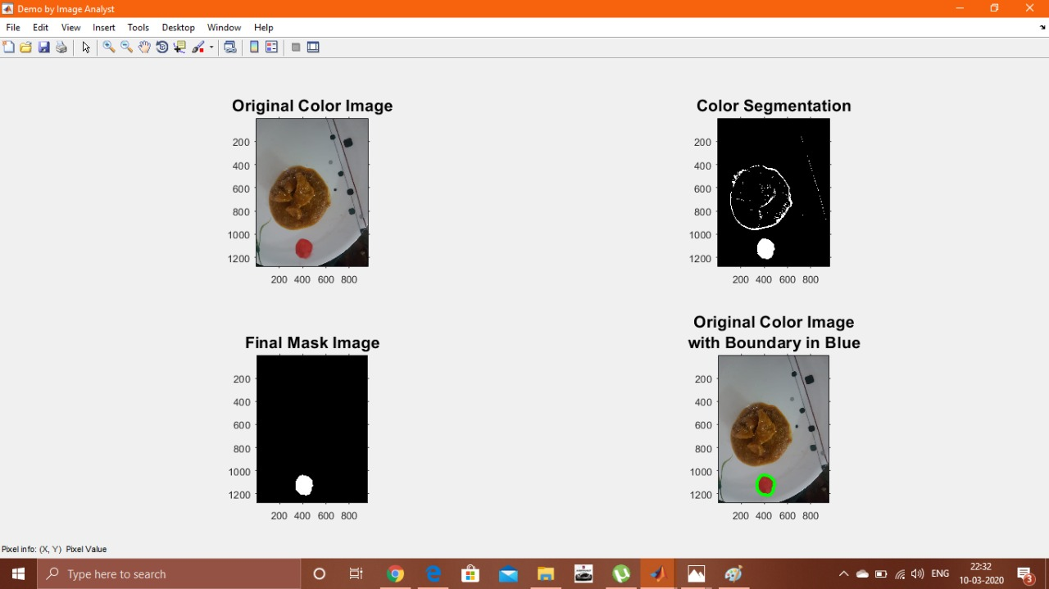
OBJECT RECOGNITION
Red dot detection using Matlab in a non-veg plate

Slide 19
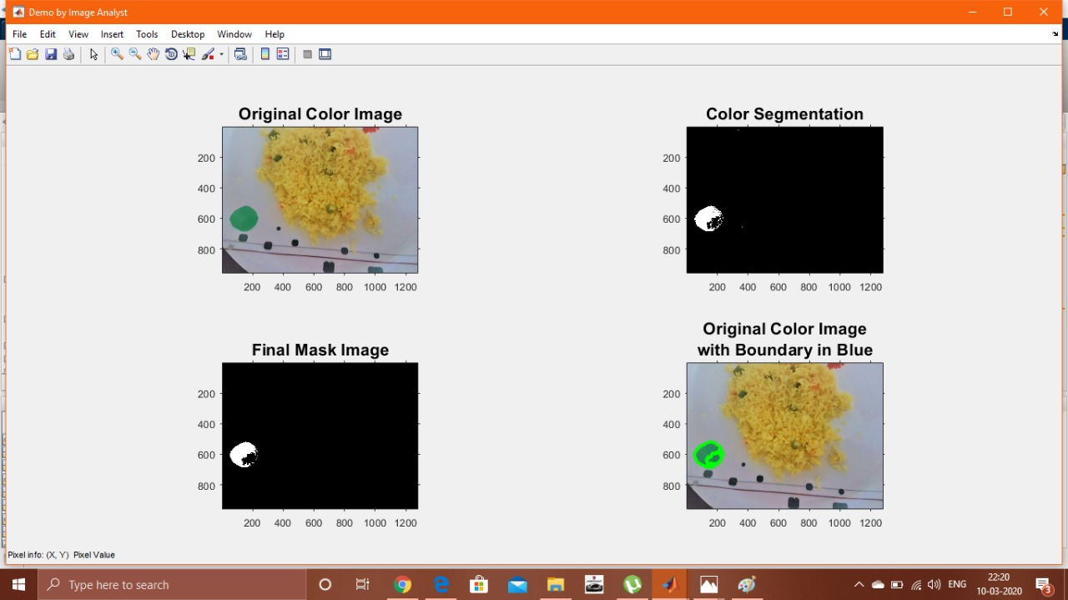
OBJECT RECOGNITION
Green dot detection using Matlab in a veg plate

Slide 20
DATABASE MANAGEMENT IN ANDROID
An Application has been developed by the team for the database management.
The application is directly connected to google Firebase servers for the database collection.
This feature helps the app to pull data from any location it may be as the applications are connected through the cloud servers thus serving the purpose

Slide 21
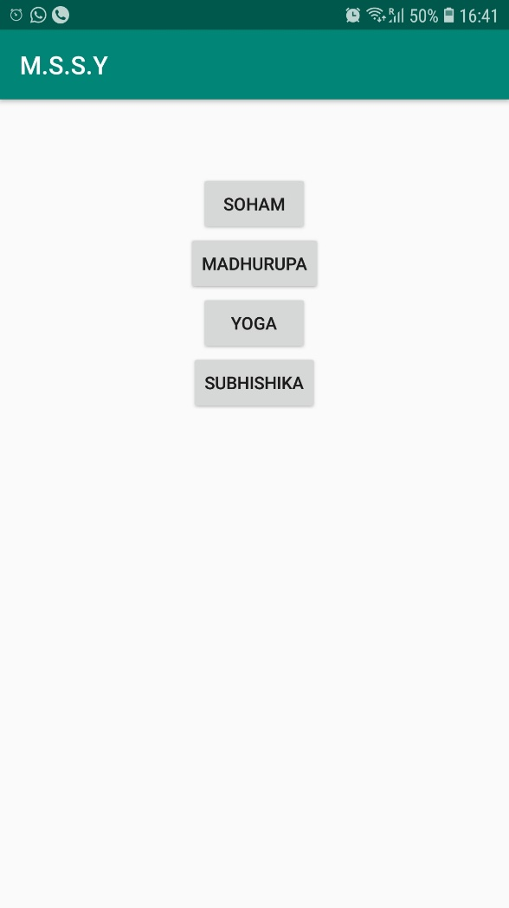
DATABASE MANAGEMENT IN ANDROID
The first page of the application showing the list of Customers

Slide 22
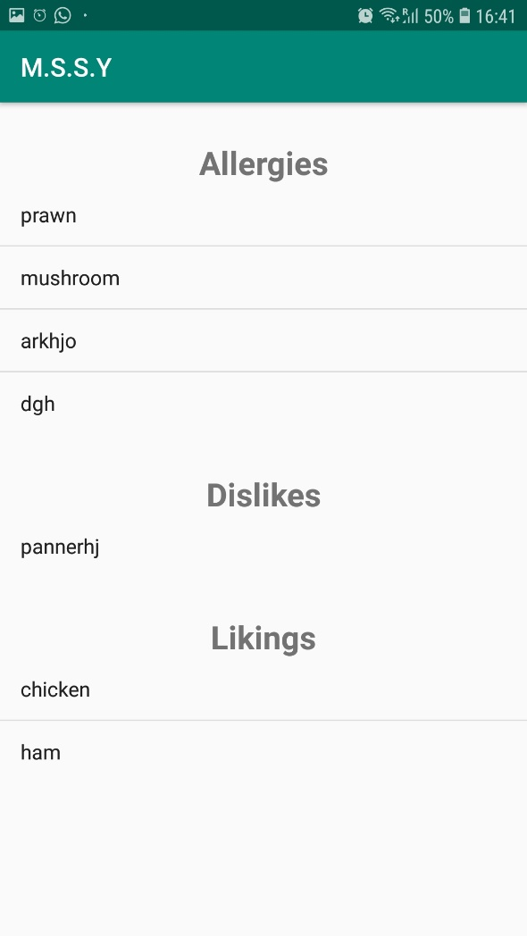
DATABASE MANAGEMENT IN ANDROID
The second page of the application for displaying the details of every customer

Slide 23
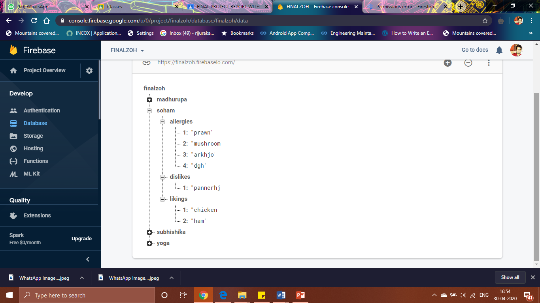
DATABASE MANAGEMENT IN ANDROID
Google Cloud Services Firebase for dumping all the data collected and accessing it through different devices

Slide 24
How object recognition works:
We can use a variety of approaches for object recognition. Recently, techniques in machine learning and deep learning have become popular approaches to object recognition problems. Both techniques learn to identify objects in images, but they differ in their execution.
Machine learning and deep learning techniques for object recognition.
The following section explains the differences between machine learning and deep learning for object recognition, and it shows how to implement both techniques

Slide 25
How voice recognition works :
Correlation is normally used in signal processing , where you need to compare two signals and need to find the similarity between them. It is also know as the dot product of those two signals.
Correlation has many uses. Correlation is also used for pattern recognition like if we want to find some pattern in the signal then we can use Correlation.
Anyway, in our project we are using correlation to find similarity between our stored signals and the testing signal.

Slide 26
Integrate object recognition in a single workflow:
MATLAB can unify multiple domains in a single workflow.
With MATLAB, you can do your thinking and programming in one environment. It offers tools and functions for deep learning and machine learning, and also for a range of domains that feed into these algorithms, such as robotics, computer vision, and data analytics.

Slide 27
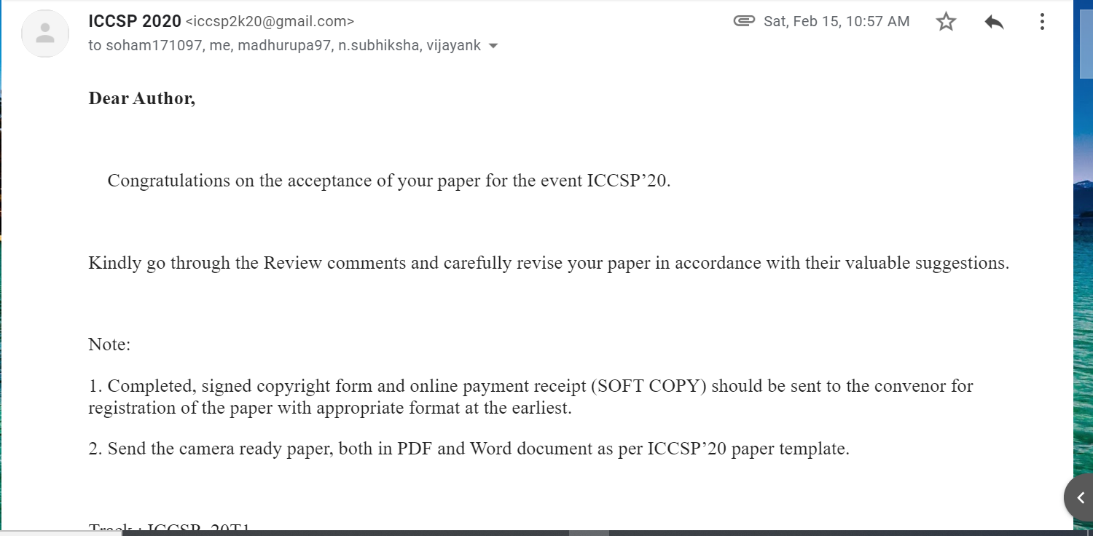
Acceptance of the paper in an IEEE conference:

Slide 28
References:
S. Sasano, X. Han and Y. Chen, "Food recognition by combined bags of color features and texture features," 2016 9th International Congress on Image and Signal Processing, BioMedical Engineering and Informatics (CISP-BMEI), Datong, 2016, pp. 815-819.
M. Wazumi, X. Han, D. Ai and Y. Chen, "Auto-recognition of food images using SPIN feature for Food-Log system," 2011 6th International Conference on Computer Sciences and Convergence Information Technology (ICCIT), Seogwipo, 2011, pp. 874-877.

Slide 29
W. Zhang, D. Zhao, W. Gong, Z. Li, Q. Lu and S. Yang, "Food Image Recognition with Convolutional Neural Networks," 2015 IEEE 12th Intl Conf on Ubiquitous Intelligence and Computing and 2015 IEEE 12th Intl Conf on Autonomic and Trusted Computing and 2015 IEEE 15th Intl Conf on Scalable Computing and Communications and Its Associated Workshops (UIC-ATC-ScalCom), Beijing, 2015, pp. 690-693
J. Meng, J. Zhang and H. Zhao, "Overview of the Speech Recognition Technology," 2012 Fourth International Conference on Computational and Information Sciences, Chongqing, 2012, pp. 199-202. doi: 10.1109/ICCIS.2012.202
G. K. Berdibaeva, O. N. Bodin, V. V. Kozlov, D. I. Nefed'ev, K. A. Ozhikenov and Y. A. Pizhonkov, "Pre-processing voice signals for voice recognition systems," 2017 18th International Conference of Young Specialists on Micro/Nanotechnologies and Electron Devices (EDM), Erlagol, 2017, pp. 242-245.

Slide 30
Team Role:
Soham Dasgupta – Responsible for the code of the project.
Yogalakshmi C.N. – Responsible for database management
Madhurupa Samaddar – Responsible for methodology and fixing the problem statement of the project with respect to the novelty of the project
Subiksha – Responsible for procurement of necessary research papers.

Slide 31
Thank You

